Slide 1
Movies Rating Distribution Analysis
Zimu Su/ Metis Business project

Slide 2
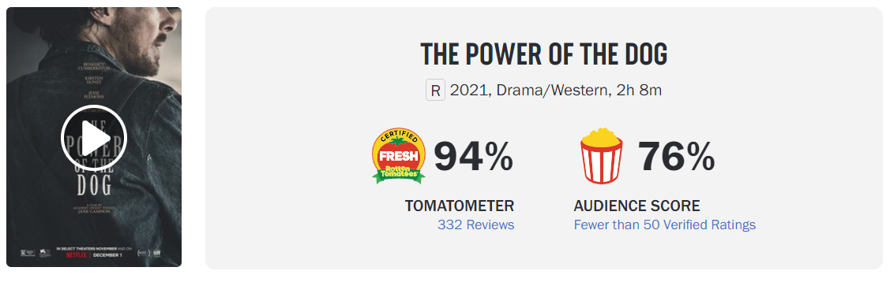
Ineligible impact of movie user score
woven into the ticket-buying behavior.
affect box-office performance.
influence the decision to make a movie.
important in recommendation system
….

Slide 3

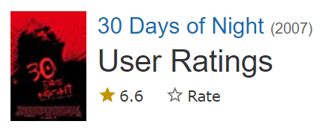
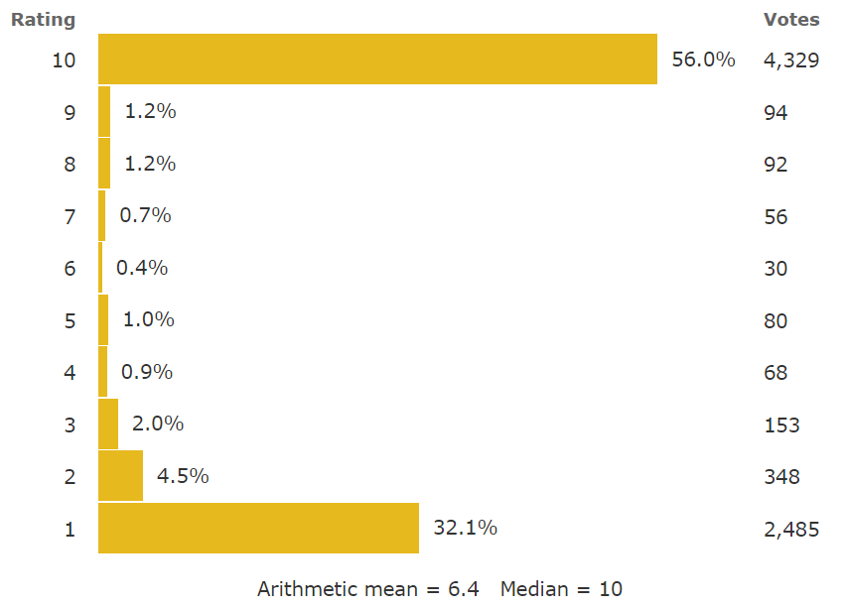
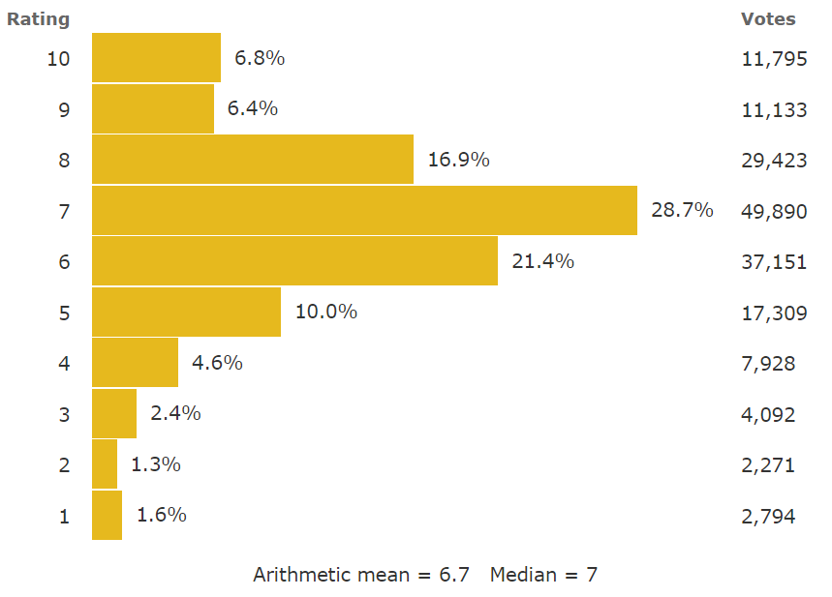
Problem: Average scores removes distribution information.
The above two movies with completely different distribution give the almost same average scores.
Distribution-based score analysis can provide elaborate audience’s feedback.

Slide 4
Movie Feature
Genres ,Release date, Title, Budget, Cast…
Overview of distribution-based model
Rating distribution
(Mediator)
Investigate/ Predict box office performance, popularity.
Improve recommendation system.
Investigate/predict audience type for popularity/unpopularity ratings.
….

Slide 5
Solution path
Identify rating distribution
(rating info from Grouplens)
Identify relationship between movies features and distribution pattern.
Use probability distribution function to characterize the shape.
Regression analysis between features and distribution pattern.

Slide 6
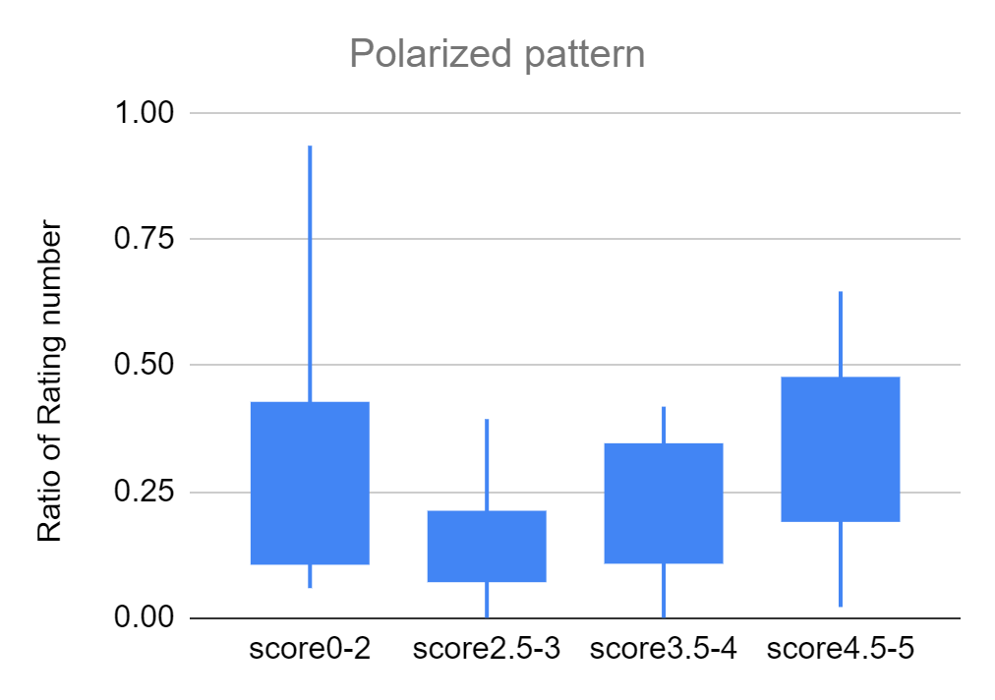
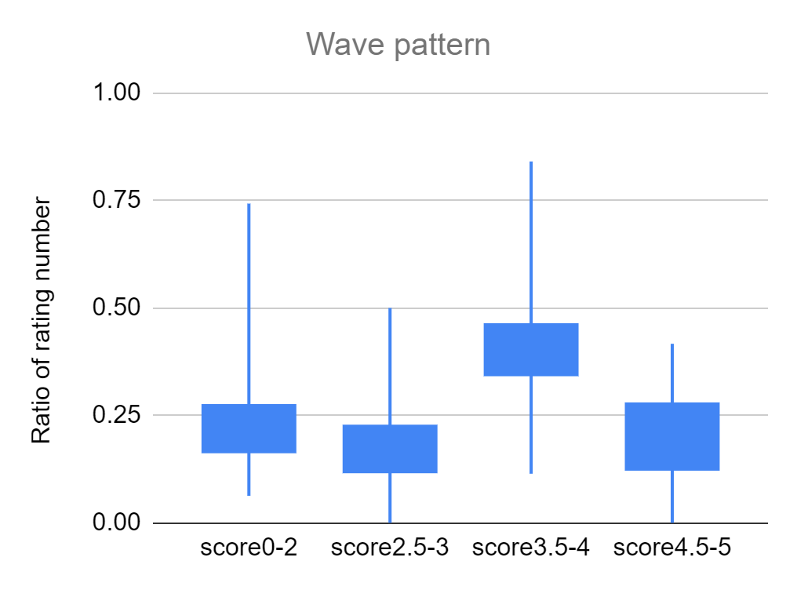
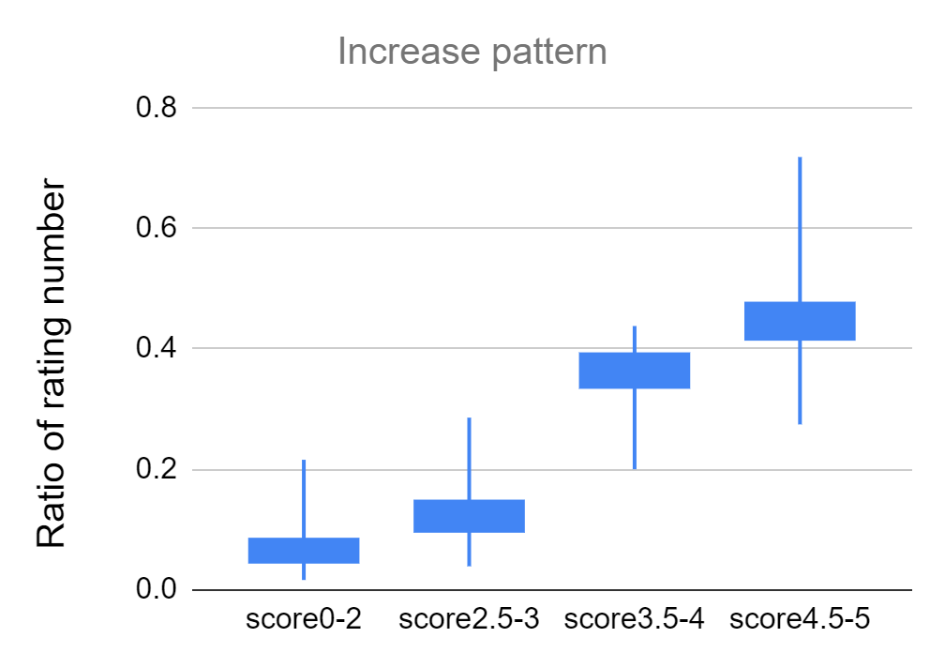
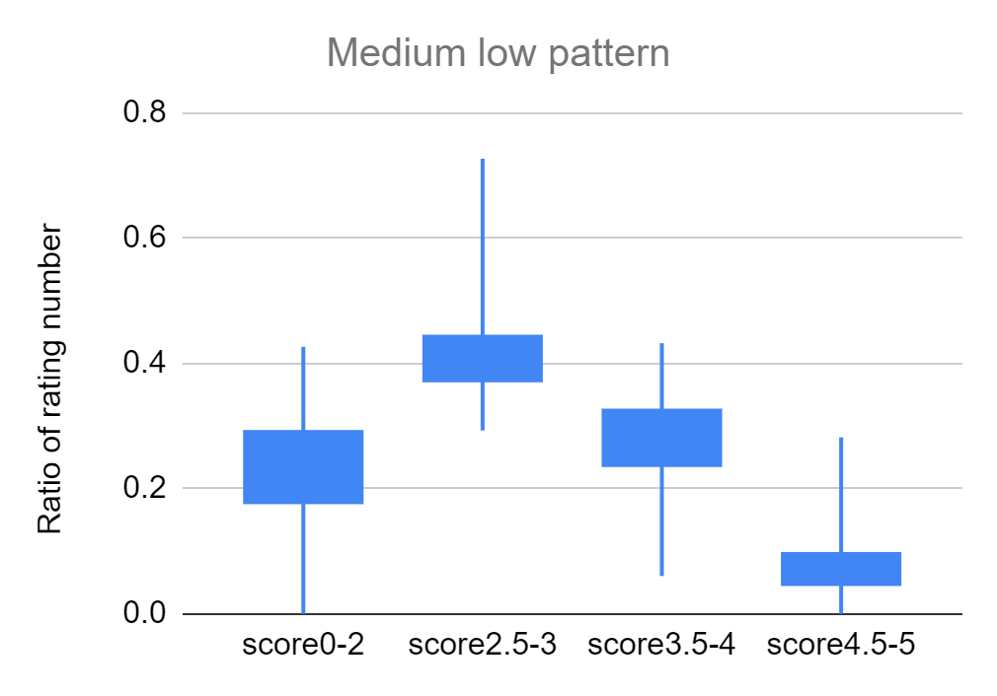
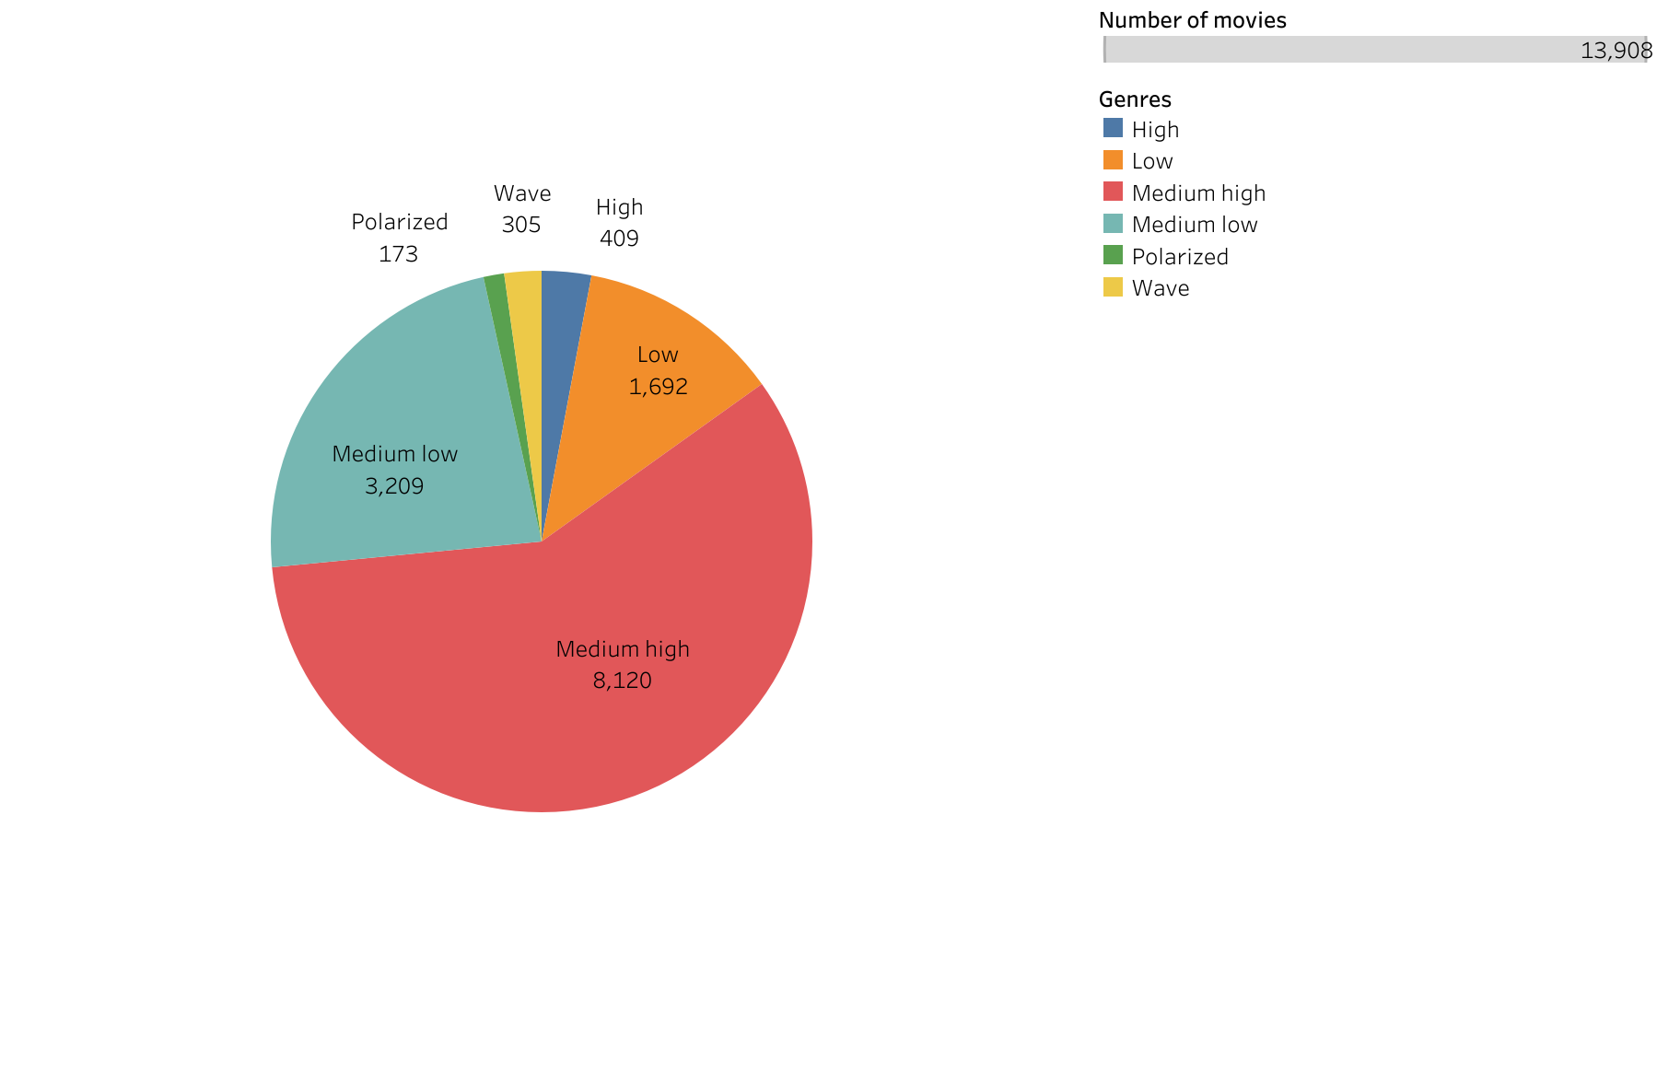
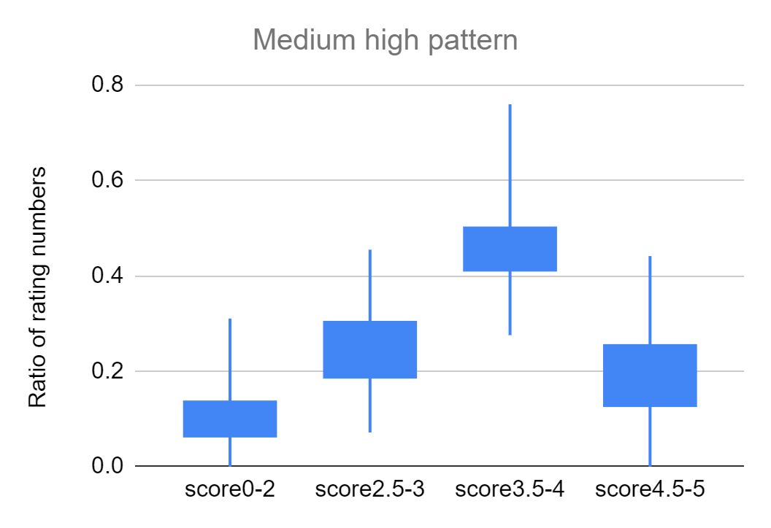
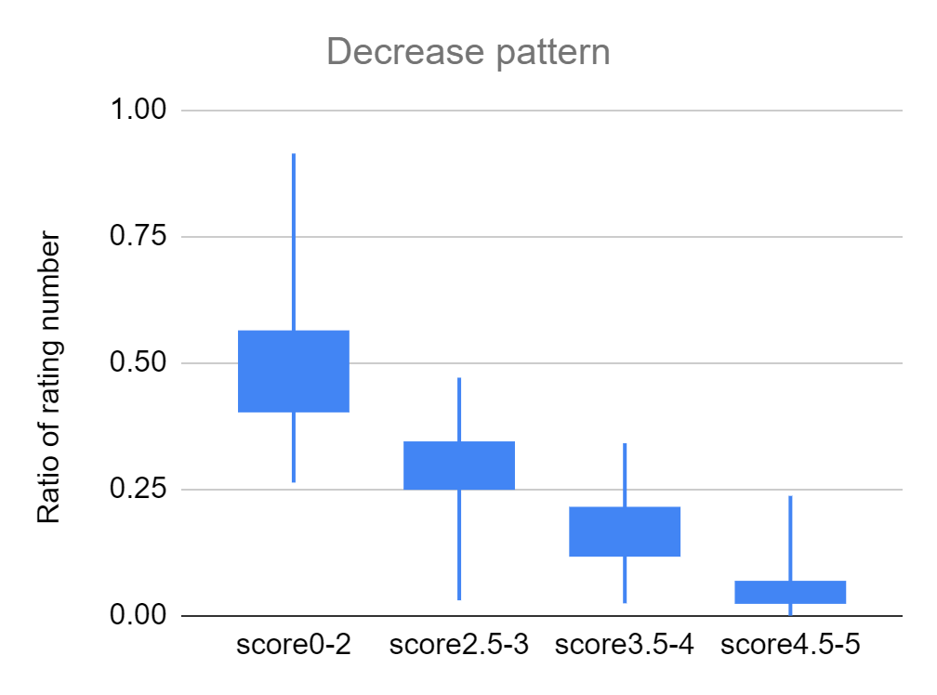
Distribution analysis
Polarized
Wave rating
High
Medium low
Medium high
Low

Slide 7
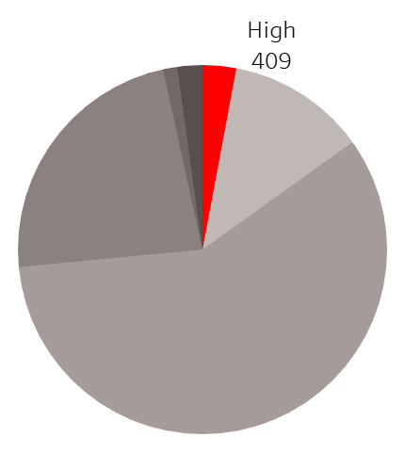
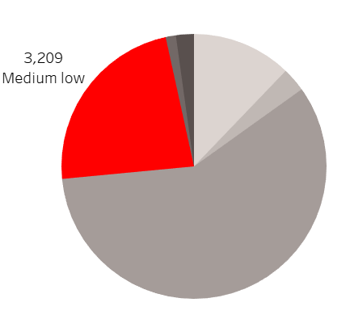
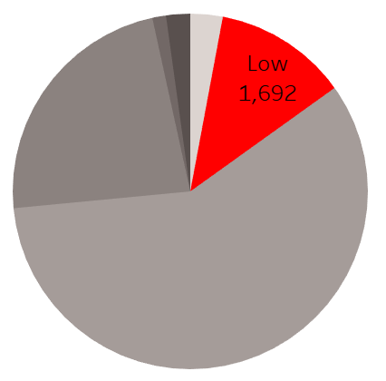
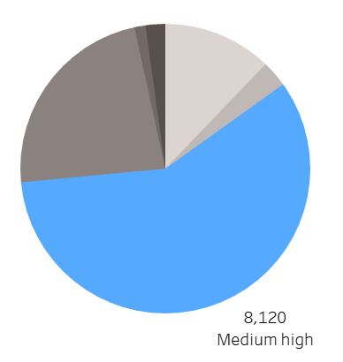
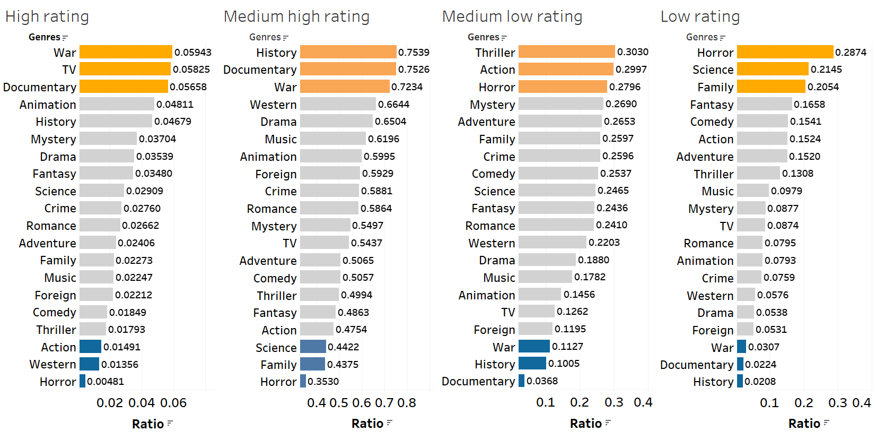
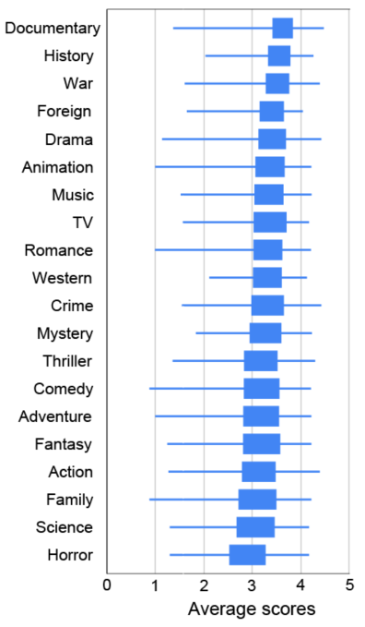
Genre analysis

Slide 8
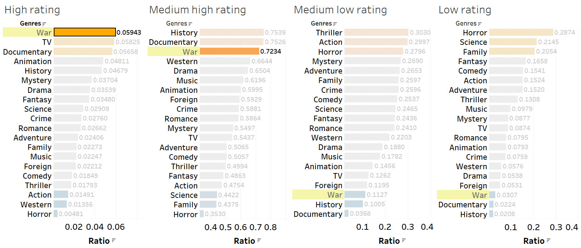
Consistent good rating
Other examples: Documentary, animation, history

Slide 9
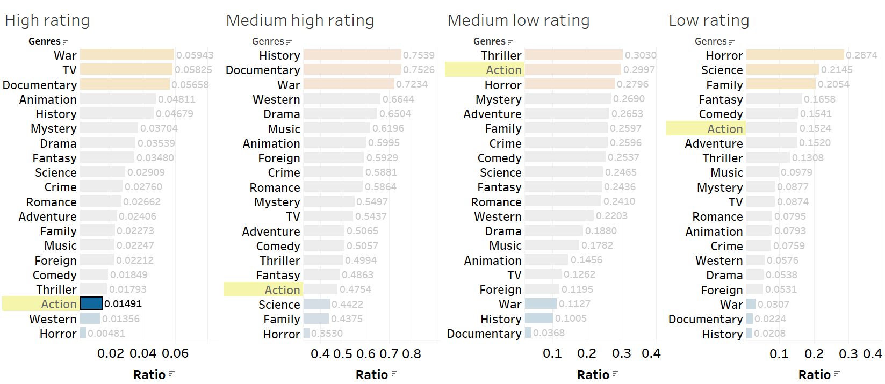
Consistent bad rating
Other examples: Horror, Thrill

Slide 10
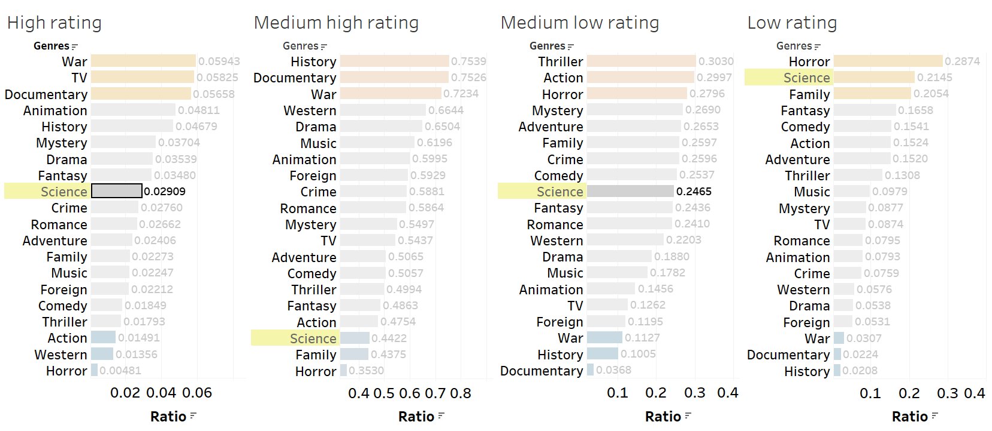
Some are excellent but most of them are bad
Other examples: Fantasy, Mystery, Adventure

Slide 11
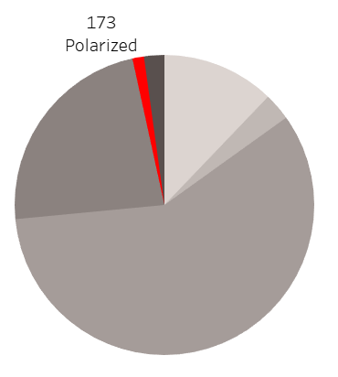
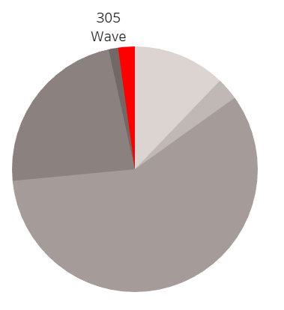
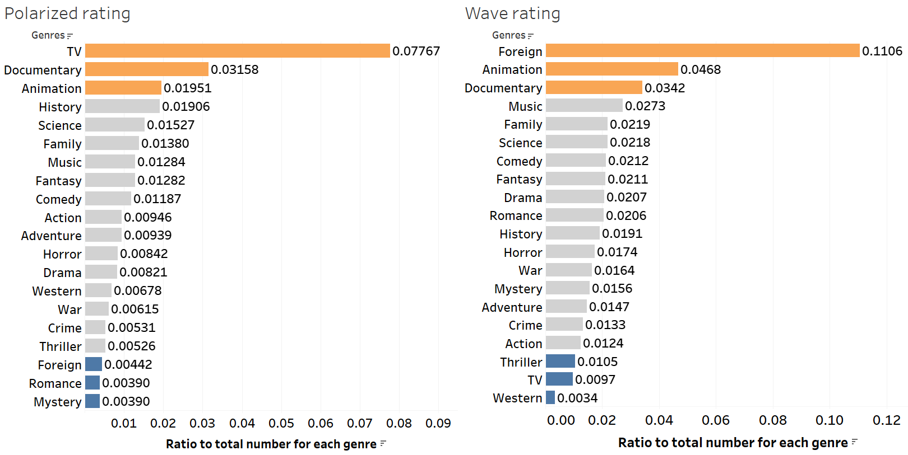
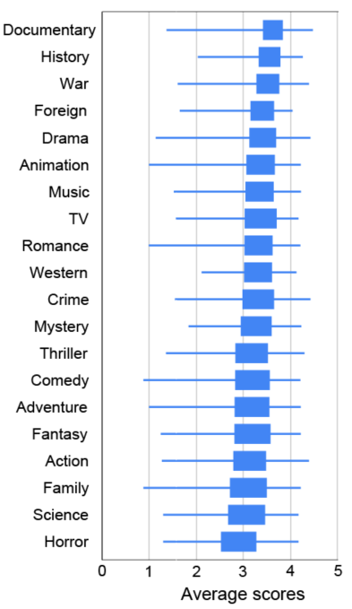
Genre analysis of controversial movies

Slide 12
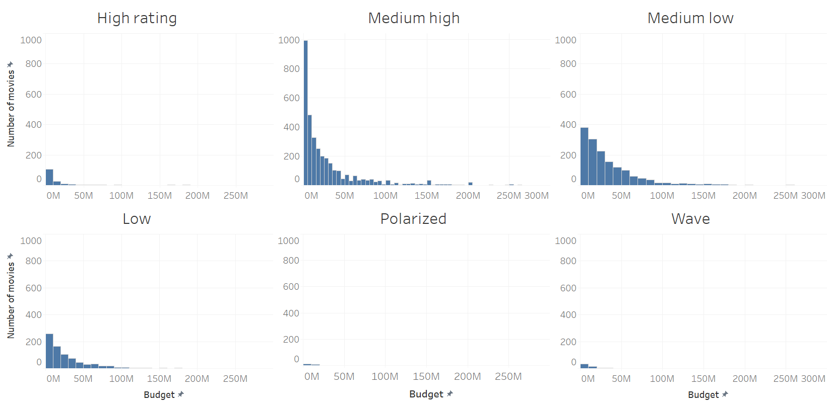
Budget analysis
Most of high rating movies is low-cost.
Controversial movies usually have not so much budget as other movies.

Slide 13
Next step:
Parameterize the distribution shape.
Incorporate more features such as title, cast, director, etc.
Build regression model between features and distribution/categories and parameters.

Slide 14
Thank you

